Slide 1


Designing Advanced Applications
Eric Franz | Solution Lead
www.concurrency.com

Slide 2
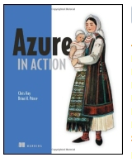
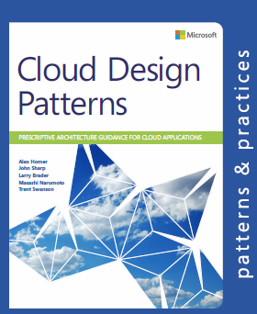


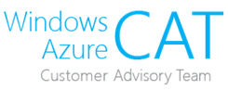

Designing Advanced Applications
Eric Franz | Solution Lead
www.concurrency.com

Slide 3
Exam 70-534 Architecting Microsoft Azure Solutions
#1 Design Azure Resource Manager (ARM) networking (5–10%)
Design Azure virtual networks - Extend on-premises
Describe Azure VPN and Express Route architecture and design
#2 Secure resources (20–25%)
Secure resources by using managed identities
Secure resources by using managed identities
Secure resources by using identity providers
Identify an appropriate data security solution
Design a role-based access control (RBAC) strategy
Manage security risks by using an appropriate security solution
#3 Design an application storage and data access strategy (5–10%)
Design data storage
Select the appropriate storage option
#4 Design advanced applications (20–25%)
Create compute-intensive applications
Create long-running applications
Integrate Azure services in a solution
Implement messaging applications
Implement applications for background processing
Design connectivity for hybrid applications
#5 Design Azure Web and Mobile Apps (5–10%)
Design Web Applications
Design Mobile Applications
#6 Design a management, monitoring, and business continuity strategy (20–25%)
Design a monitoring strategy
Describe Azure business continuity/disaster recovery (BC/DR) capabilities
Design a disaster recovery strategy
Design Azure Automation and PowerShell workflows
Describe the use cases for Azure Automation configuration
#7 Architect an Azure Compute infrastructure (10–15%)
Design ARM Virtual Machines (VMs)
Design ARM template deployment
Design for availability
+ Bonus: Containers
https://www.microsoft.com/learning/en-us/exam-70-534.aspx
Notes:
Hi my name is

Slide 4
What is Cloud Computing
Cloud thinking
Utility
Elasticity
A new way of designing applications
?
Notes:
Cloud thinking
Cloud computing is really about cloud thinking
Utility
Hair dryer
Elasticity
Scale out!
Pay for what you use
We are talking public cloud today not private
(Private clouds give you elasticity, but all you’ve done is probably altered procurement model)
A new way of designing applications
WE WILL BE TALKING ABOUT
Really designing for distributed computing – CLOUD THOUGHT – SO IMPORTANT – WE”LL BE SPENDING A LOT OF TIME HERE
Mean time to failure, time to recover (ROC recovery oriented computing)
Partitioning
Availability, etc
Resilience
SLAs

Slide 5

Out of Pickles?

Slide 6
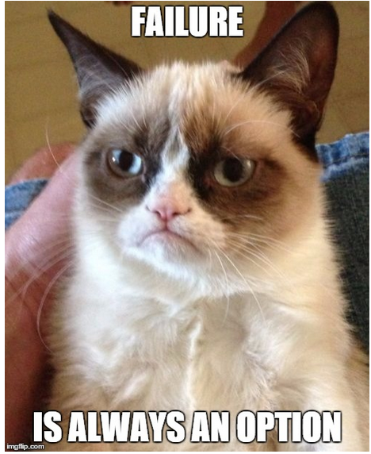
Notes:
What a perfect slide to come after the success slide.
QUESTION: What is the YSOD, yellow screen of death.
Why do we as developer design software which fails by not recovering?
Components could fail, Services could fail but the “SYSTEM” needs to stay up.
ANALOGY (Hot-dog stand): Out of pickles, but still selling dogs and soda.
ANALOGY (SYTEM): Airline, a plane is late, but the Airline is selling tickets and other people are still flying

Slide 7
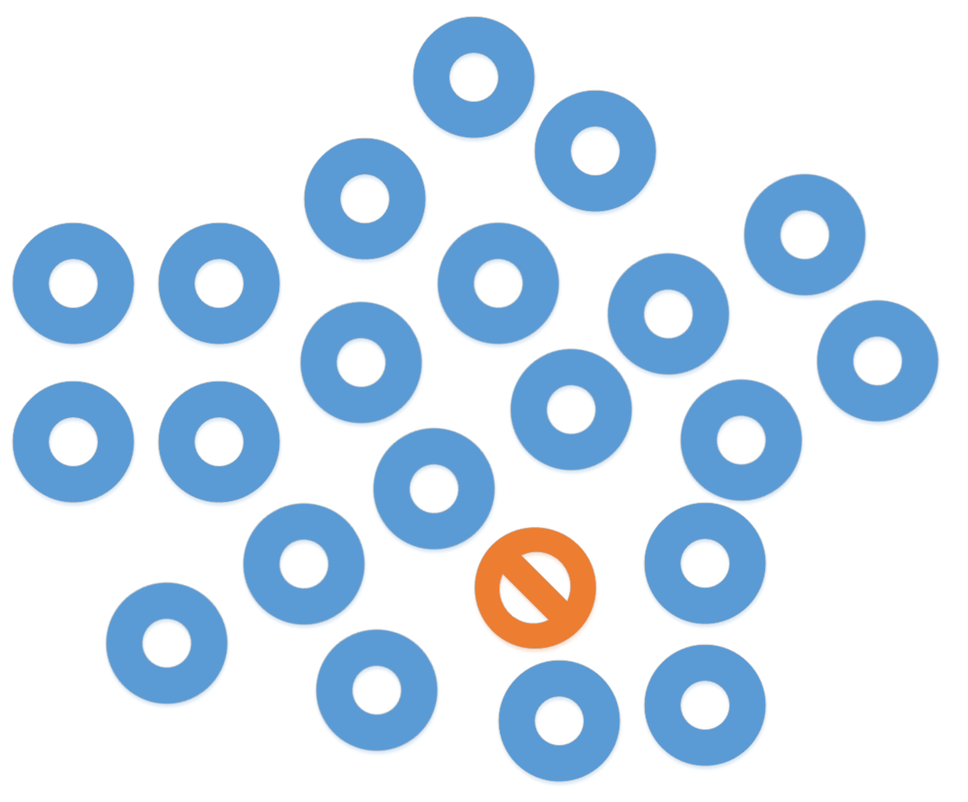
ALWAYS Failing
Notes:
Assume a part is always DOWN
So much EFFORT is spent AVOIDING failure
Autonomy
We’ve been getting lucky on small architectures due to improvements in hardware
ACTIVITY: Draw a typical 3 tier architecture (talk about failures due to transactional bounding (show it bringing down entire UI)
Mean time to fail
Time to recover TTR
Think cloud, not necessarily in the deployment sent, but in the model/thinking sense

Slide 8
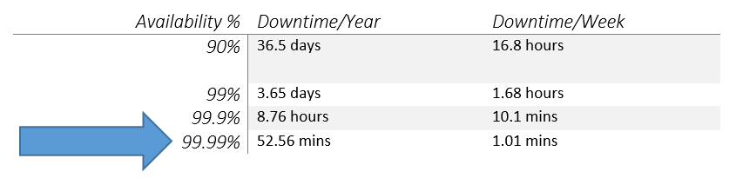
SLAs
What are some example availability SLAs
Notes:
Five Nines:
5.26 min/Year
6.05 sec/Week
Six Nines:
31.5 sec/Year
604.8 milliseconds/Week
At this point no person can be watching a dashboard, the system has to automatically be self-healing, due to latency
QUESTION: What do you think your current SLA is?

Slide 9
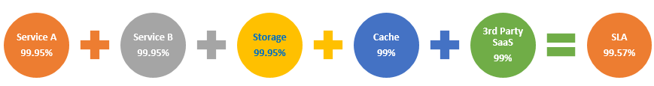
SLAs
What is your SLA?
Notes:
ACTION: Read it off slowly
Most people think you average it all together giving you 99.57%

Slide 10
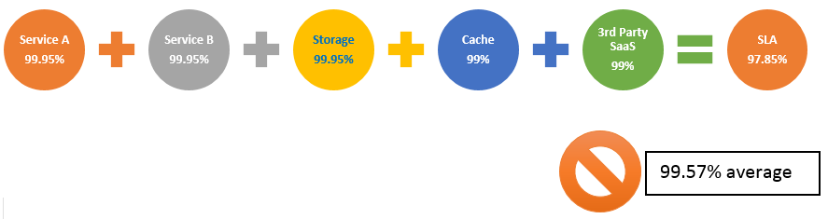
SLAs
What is your SLA?
Notes:
Your true SLA is actually around 97.85%
-NOT- the 99.57% average
You must subtract the difference as a STARTING POINT:
-> Bad code, untested code, can bring it down, and won’t make it higher unless you partition or use another switching or failover strategy

Slide 11
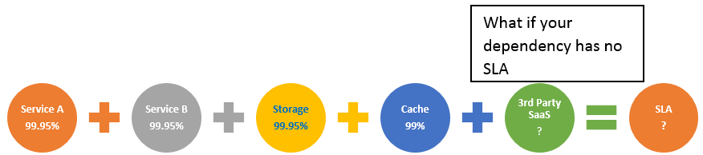
SLAs
What about 3rd Party SLAs?
Notes:
What if the 3rd Party SaaS is available, but throttling you?
You must understand and plan for it.
Perhaps you shard against it, buffer it, or even use multiple providers.

Slide 12
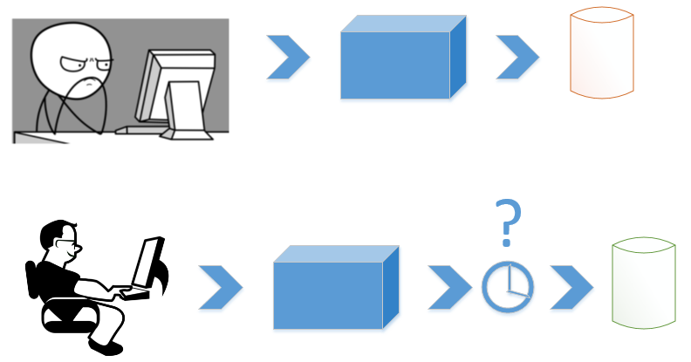
MORE Distributed Architectural Patterns
Eventual vs Strong Consistency
Notes:
Eventual vs Strong consistency
Eventually all reads (if no writes occurred) will have accurate data
-as opposed to- strong consistency or ACID transactions.
Eventual Consistency
Systems that are loosely coupled
They can have better uptime
More highly available
Strong Consistency
Action: Draw a strong consistent DB connection (he doesn’t look happy, I wonder why)
TIGHTLY COUPLED, CANT SCALE

Slide 13
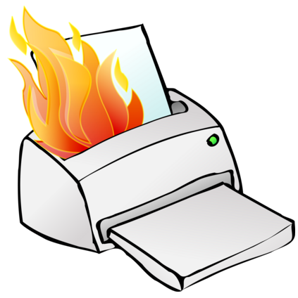
MORE Distributed Architectural Patterns
Transient Exceptions
This is the number one first thing developers face moving to the cloud.
Notes:
When dealing with services, especially services you don’t control, you will have transient faults.
Try again, back off
Linear
Exponential
Convoy Effect!!!
We all run to the door, or restaurant rush

Slide 14
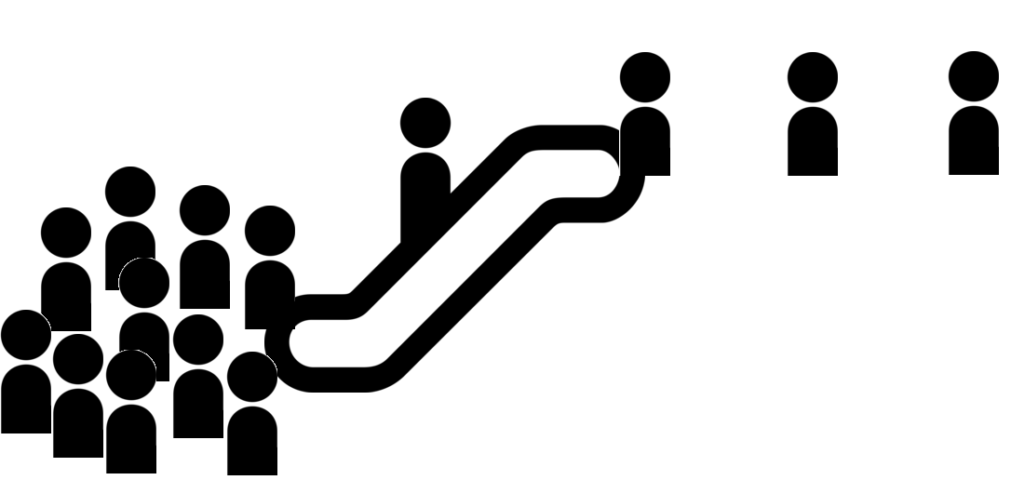
MORE Distributed Architectural Patterns
Backpressure and rate levelling
Notes:
ACTION:Discuss
Backpressure will kill your system if it’s not managed
Protect resources and SLAs with rate leveling
Use Sharded queuese (elevators in building) IN IMAGE ADD ANOTHER ESCALATOR OR TELL PEOPLE TO COME BACK LATER

Slide 15
Module Overview
Designing Advanced Applications
Messaging Options
Implement background processing
Create Long-running applications
Compute-intensive applications
Integrating Azure Services

Slide 16
Messaging
Service Bus
Queues
Topics
Azure Relay
Service Bus Tiers
Azure Storage Queue
Notes:
Not in any order.
[READ SLIDE]

Slide 17

Service bus
PaaS with no Infrastructure management
Relay capabilities to build hybrid apps
Supports AMQP and common protocols such as HTTP
Contains Event Hub, a cloud scale telemetry ingress service.
Notes:
Service Bus is a:
Application Layer Communication and Integration (not a VPN)
Helps with:
NAT and Firewall Traversal
Facilitates bi-directional flow
You have for example HTTP, TCP, AMQP
AMQP is a binary wire level protocol designed for flexible messaging. It has been an OASIS standard for 5 years.

Slide 18
Service Bus Queue
S
R
S
Queue
R
S
R
Point to point communication
FIFO order guarantee
Supports Batch Receive and Batch Send
Notes:
*Atomic operation support
Dead lettering can be useful for isolating messages that cannot be processed successfully by the receiving application or when messages cannot reach their destination due to an expired time-to-live (TTL) property. The TTL value specifies how long a message remains in the queue.
To find "poison" messages in Storage queues, when dequeuing a message the application examines the DequeueCount property of the message. If DequeueCount is greater than a given threshold, the application moves the message to an application-defined "dead letter" queue.

Slide 19
Service Bus Topic
S
R
Subs
Topic
S
R
R
R
S
R
One to many broadcasting scenarios
Filter messages
Use ReceiveBatch() or ReceiveBatchAsync() to receive a batch of messages
Notes:
////////////////////////////There are limits of 2k topics?
Don’t have to use a universal dispatcher which reads every message which figures out to do with it (via a header on content based router)
Can v1/v2 data long running process if u have a week long proeccss

Slide 20
Event Hub
Ingest messages at scale at high throughput, high volume and low latency
Typical use cases are IOT and enterprise logging
Messages are durable for 7 days
No enterprise messaging features such as dead letter queue
Notes:
[Read Slide]
In an IoT situation streamming would be more like cloud to cloud
You wont get individual device control granularity with Event Hub vs iot hub
For higher concurrent connections you would use IoT Hub
BOTH are great at streaming messages though

Slide 21
An Event Hub is created in the Service Bus Namespace
https://docs.microsoft.com/en-us/azure/event-hubs/event-hubs-what-is-event-hubs

Slide 22
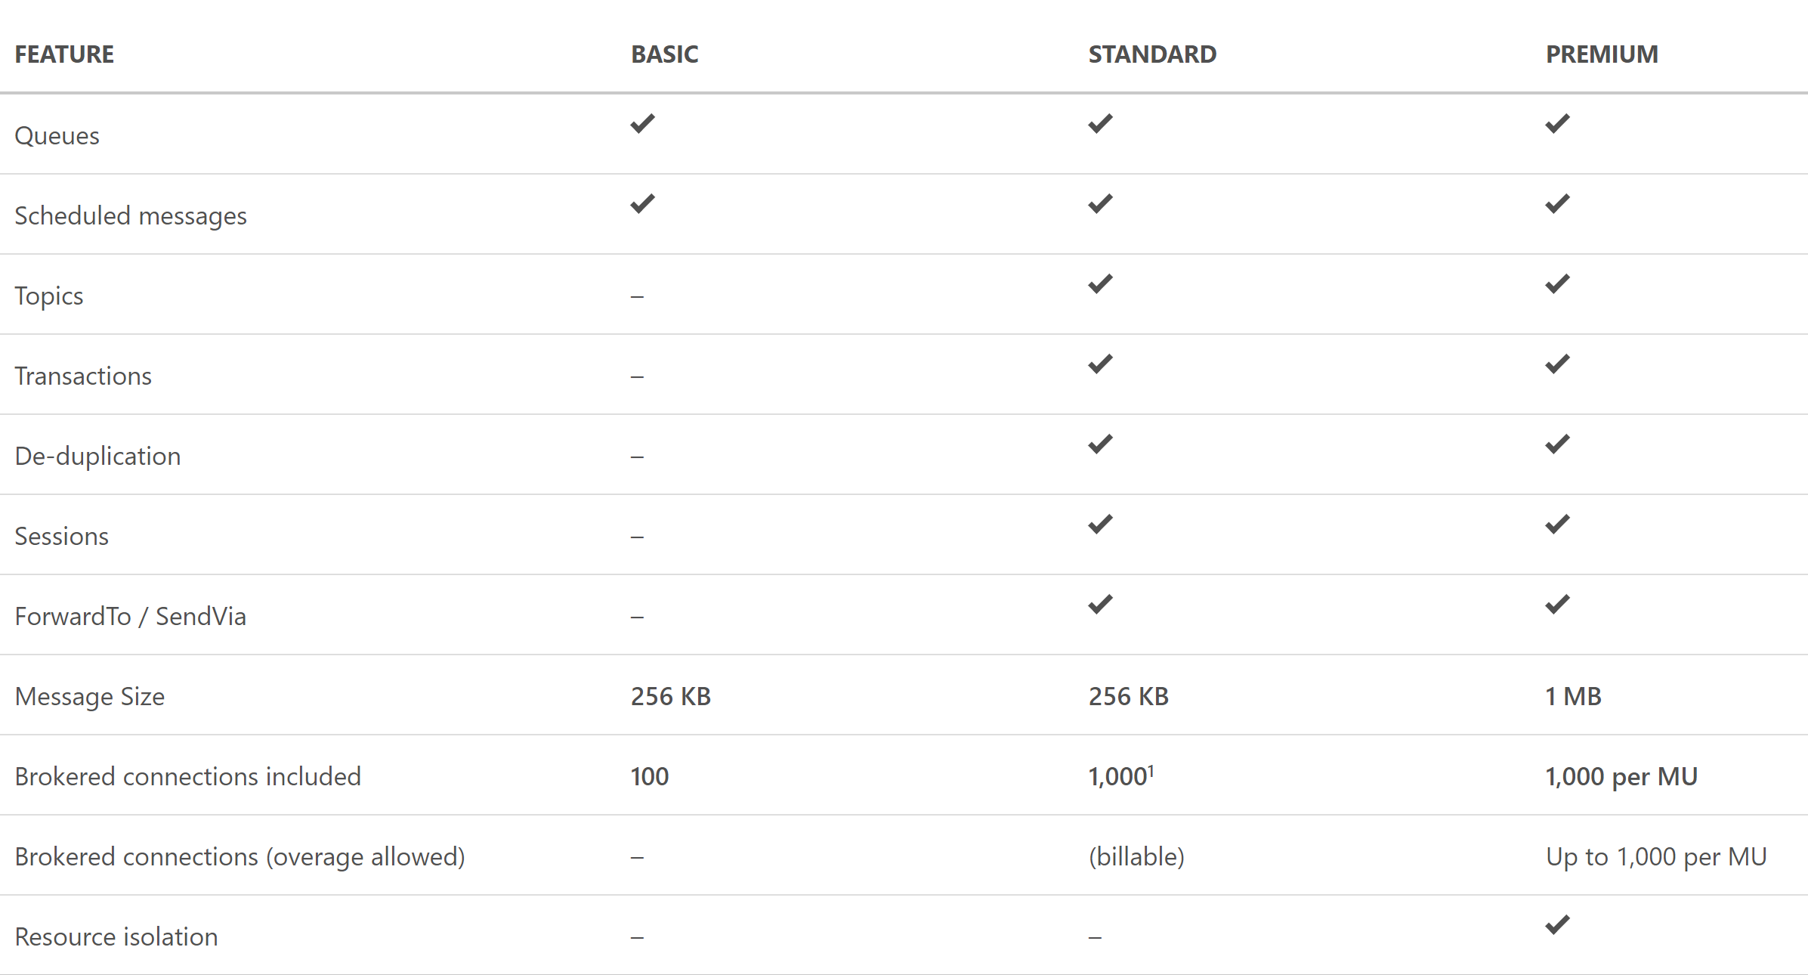
Service Bus Tiers

Slide 23
Question: You need to process IOT data from approx 700 devices. Data is fitered and moved into Blob Storage. Archival of raw ingress data is required for a week. Choose an implementation below.
IOT Hub
SQL Database
Event Hub Standard Tier
Event Hub Basic Tier
IOT Hub
SQL Database
Event Hub Standard Tier
Event Hub Basic Tier
Notes:
Key of number of devices
Ingress data is required for only a week

Slide 24
Connectivity for Hybrid Applications
Azure Relay
Hybrid connections and WCF Relay are part of the Azure Relay service
Communicate with on-premises resources without opening a firewall port
Hybrid Connections support multi-platform scenarios.
Hybrid Connections can be used to connect to any TCP port including SQL DB’s and Web API’s.
WCF Relay can communicate with WCF services and .NET Framework only.
VPN
Connect an Azure Web App to on-premises via VPN.
VNET integration gives a multi tenant Web App Access to resources accessible by an Azure VNET.
App Service Environment (ASE) can be deployed into an Azure VNET for bidirectional access.
Notes:
Relay:
Popular with ISVs+SaaS when deployed at mom and pop places

Slide 25
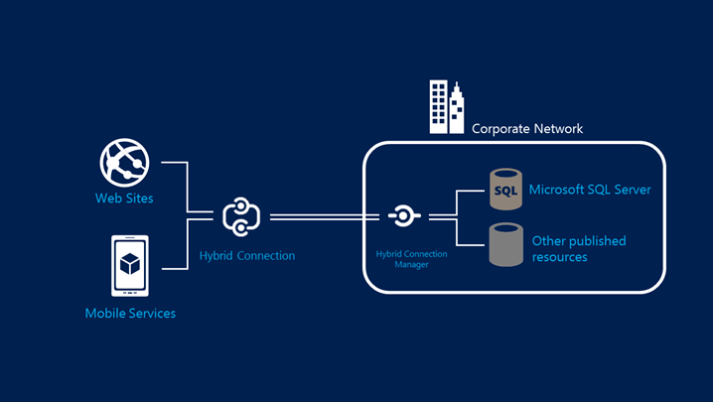
Hybrid Connections Architecture
Notes:
[BizTalk Hybrid Connection is retired by this]
Hybrid Connections benefits include:
Web Apps and Mobile Apps can access existing on-premises data and services securely.
Multiple Web Apps or Mobile Apps can share a Hybrid Connection to access an on-premises resource.
Minimal TCP ports are required to access your network.
Applications using Hybrid Connections access only the specific on-premises resource that is published through the Hybrid Connection.
Can connect to any on-premises resource that uses a static TCP port, such as SQL Server, MySQL, HTTP Web APIs, and most custom Web Services.
TCP ports
Hybrid Connections require only outbound TCP or HTTP connectivity from your private network. You do not need to open any firewall ports or change your network perimeter configuration to allow any inbound connectivity into your network.

Slide 26
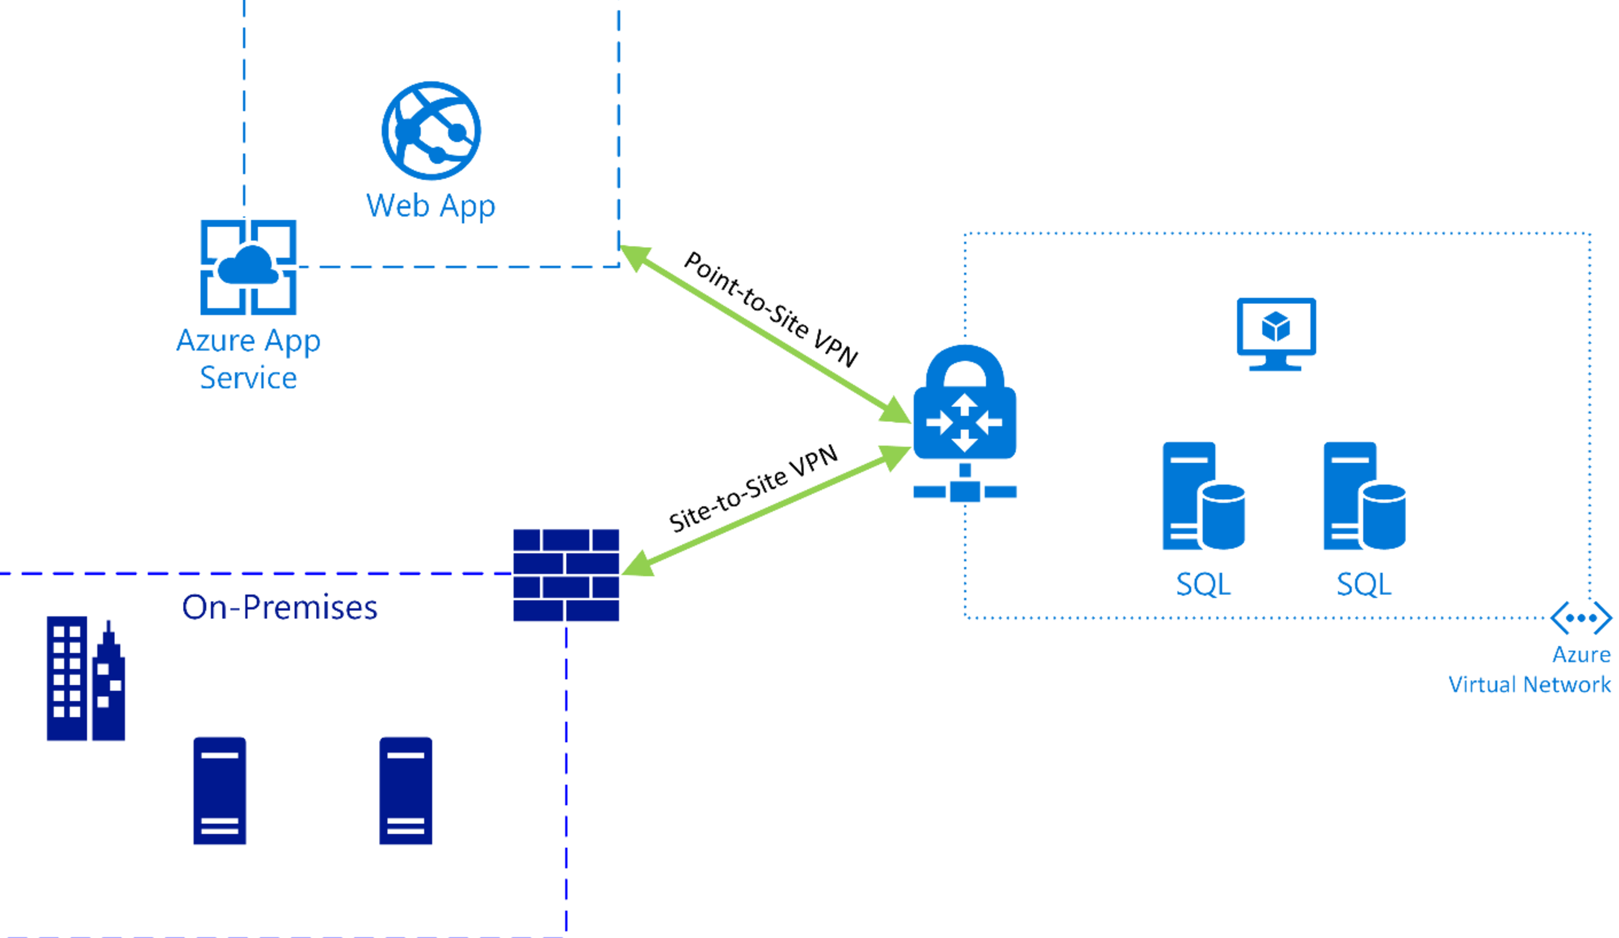
Azure Web App VNET Integration
Notes:
The key is to know what is possible in the exam

Slide 27
Question: Your app needs a brokered messaging channel to an on premises line of business application that offers a WCF endpoint to clients. You need to implement connectivity without changing on-premises firewall rules. Implementation needs to have a lower cost compared to other options. Choose an implementation below.
Express Route
Site to Site VPN
Hybrid Connection
WCF Relay
Express Route
Site to Site VPN
Hybrid Connection
WCF Relay
Notes:
TWO OF THESE DON’T REQUIRE FIREWALL RULES
WCF relays are charged by message volume and relay hours.
Relay hours$0.10 for every 100 relay hours
Messages$0.01 for every 10,000 messages

Slide 28



Azure Storage Offerings
Blobs
Files
Disks
Tables
Queues
Object storage
Access via REST
File storage
Access via SMB, REST
IaaS VM VHD/ disks
Access via REST
NOSQL storage
Access via REST
Reliable Messaging
Access via REST
Streaming & random object access scenarios
Lift n shift scenarios
Persistent disks for VMs
Premium option
KeyValue Store
Scheduling async tasks
Notes:
Lwiin covered some of these before

Slide 29
Implement background processing
Azure Web Jobs
Azure Functions

Slide 30
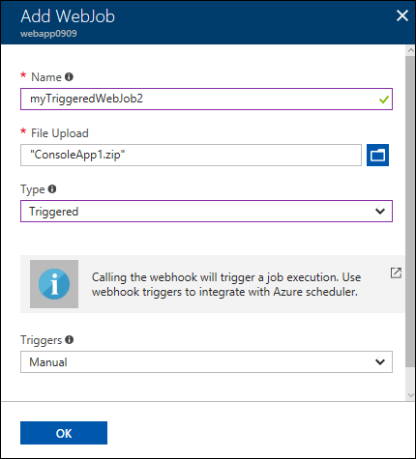
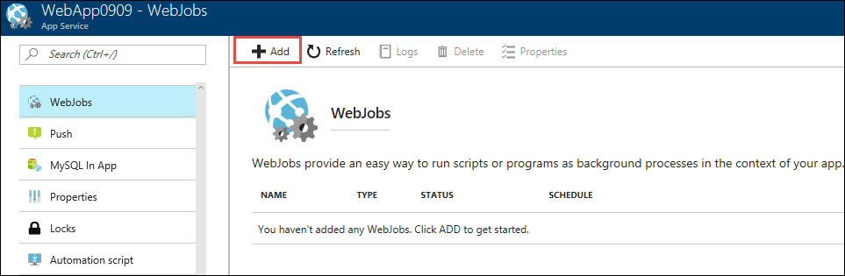
Azure Web Jobs
WebJobs provide an easy way to run scripts or programs as background processes in the context of an App Service, API App or Mobile App
Web jobs can be scheduled , continuous or on-demand
You can upload and run an executable file
such as as cmd, bat, exe (.NET),
ps1, sh, php, py, js, and jar.
Notes:
WebJobs is a feature of Azure App Service that enables you to run a program or script in the same context as a web app, API app, or mobile app. There is no additional cost to use WebJobs.

Slide 31
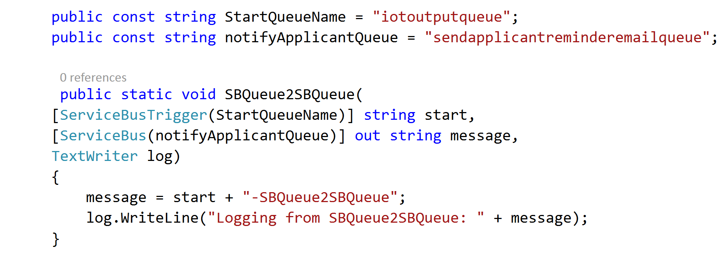
Azure Web Jobs
Notes:
Using the SDK:
Here is an example of just how easy it is to listen to an SB QUEUE and write that to another SB QUUEE
We can also log to portal dashboard

Slide 32
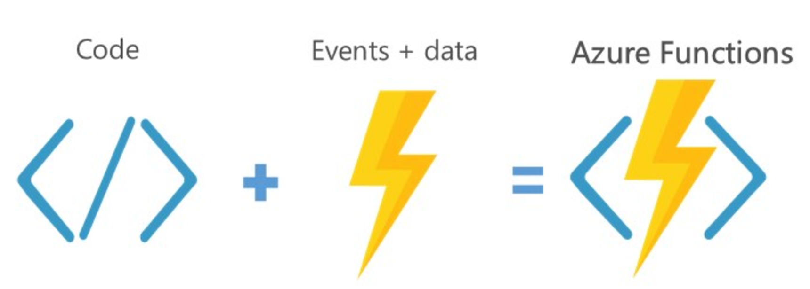
Azure Functions
Server less, highly available and scalable architecture
Supports programming in Node, Javascript, C#, Python and PHP and various CI options.
Suitable for trigger based action.
Web Jobs SDK can be used for local dev and test.
Notes:
[Read Slide]
This is only a little over 1.5 years old (previewed then)
Triggers are: Blobs added/changed, Timer, WebHook, GitHub Web Hook, Azure Queue msg submission, data added/changed in Cosmos DB
Functions pricing includes a monthly free grant
of 400,000 GB-s.
A function with observed memory consumption of 512 MB executes 3,000,000 times during the month and has an execution duration of one second. Monthly billing would be around $18

Slide 33
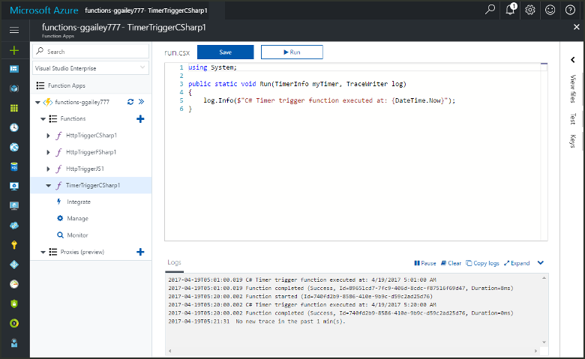

Slide 34
Question: You are trying to implement a background process to send emails on a scheduled interval. Which Azure function triggers would be suitable?
Event Hub
Blob Storage
HTTP
Timer
Event Hub
Blob Storage
HTTP
Timer

Slide 35
Create Long Running Applications
Azure Scheduler
Azure Batch

Slide 36
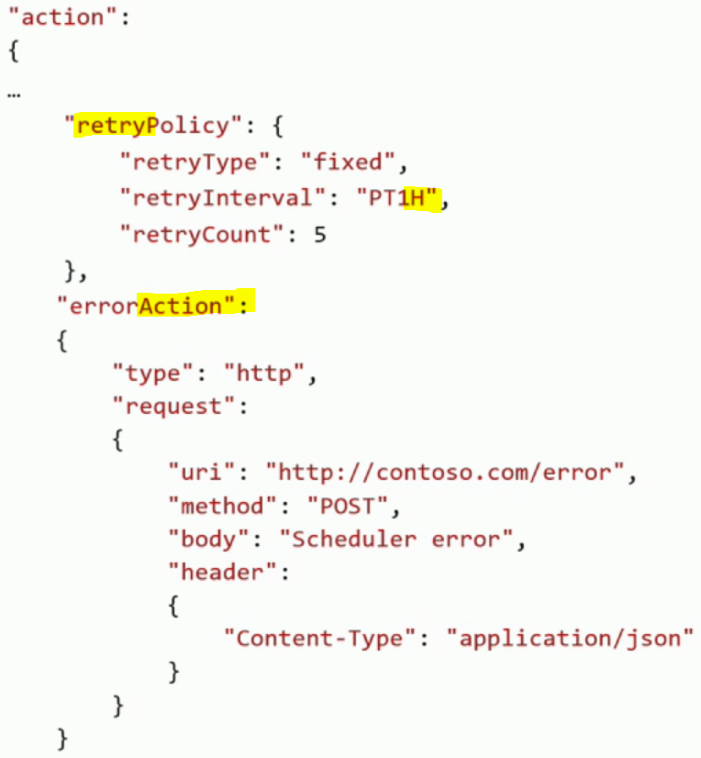
Azure Scheduler
Platform service for scheduling reliable actions on a recurrent , simple or complex schedule.
Supports Service bus relay for hybrid scenarios
High availability built in.
Configurable retry policy
Notes:
[Read slide]
Invoke actions such as calling HTTP/S endpoints or posting a message to a storage queue on any schedule. With Microsoft Azure Scheduler, you create jobs in the cloud that reliably call services both inside and outside of Microsoft Azure and run those jobs on demand or on a regularly recurring schedule, or designate them for a future date. This service is currently available as a standalone API.
Use Scheduler to:
Invoke a Web Service over HTTP/s
Post a message to an Azure Storage Queue
Post a message to an Azure Service Bus Queue
Post a message to an Azure Service Bus Topic
HA:
Scheduler operates during network, computer, and datacenter failures, so your scheduled jobs continue to execute on time. It automatically switches to an alternative datacenter in the same region, if needed.

Slide 37
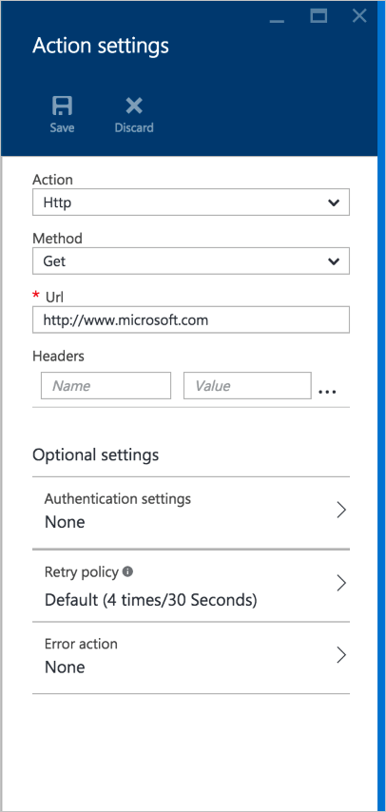
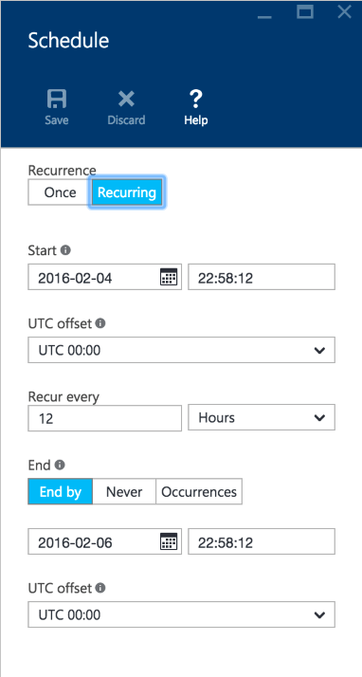
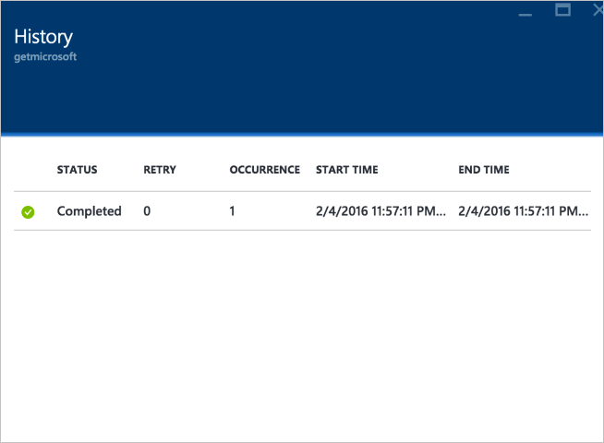
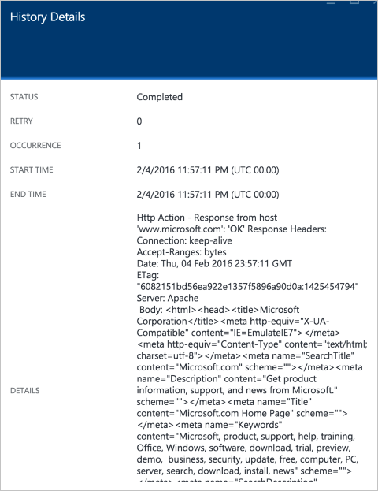
Azure Scheduler
Notes:
Pricing:
Check the pricing page, but for 13.99/month you can get 21.6M executions of a job per month in the STANDARD Plan
Remember that gives u the loging and historical information

Slide 38
Azure Batch
Platform Service for Developers providing job scheduling and VM management as a service allowing applications to be run in parallel at scale.
Batch Pools:
Configure and create VM’s for any scale; less than 10 or more than 10,000.
Both Windows and Linux supported
Low Priority VM’s launched
Batch Jobs and Tasks:
Task is a unit of execution. Anything that can execute from a command line such as EXE, BAT, CMD, PS1 etc.
Run applications unchanged.
Jobs are submitted, Tasks are assigned to VM’s.
Automatic detection and retry of frozen tasks.

Slide 39
Azure Batch — Job Scheduling as a Service
User application or service
Azure Batch
Foundational batch processing service
Avoid building infrastructure
VM management and job scheduling
PaaS
Cloud Services
IaaS
Virtual Machines
Hardware

Slide 40
Question: Your company needs to run large scale computation workloads. The compute cluster should be able to scale up and down on demand. You are looking for a cost effective option which can be managed by via command line scripting. Choose an option below.
Azure Batch
HPC Pack
Web Jobs
Azure Functions
Azure Batch
HPC Pack
Web Jobs
Azure Functions

Slide 41
You do not to create a virtual network or Scheduler before creating an Azure Batch Service.
https://azure.microsoft.com/en-us/services/batch/

Slide 42
Compute-intensive Applications
HPC

Slide 43
Big Compute Use Cases
Media transcoding
Rendering
Image analysis & processing
Builds
Test execution
Fluid dynamics
Monte Carlo simulations
Engineering stress analysis
Risk Analysis
Massive parallel computation
AI and Deep learning
APP
Many individual tasks
Tasks assigned to VMs
Independent or coupled tasks
INPUT
OUTPUT

Slide 44
Big Compute evolution
HPC Pack
On-premises
HPC Pack
Hybrid
HPC Pack
IaaS
Azure Batch
PaaS
On-premises Windows clusters
Easy scaling to reduce runtimes
Job scheduling and management
Compute node provisioning
Extend cluster to cloud to handle peak demand
Leverages platform as a service virtual machines
Secure packaging and distribution
Automated deployment of Azure VMs
Deploy cluster all in cloud
Move existing applications
Support projects and testing
Gallery images and scripts to deploy
Flexible VM configuration
Native cloud scheduler
Devops, not infrastructure management
Small to very large deployments
Elasticity with auto-scale
Use within a service or to offer SaaS
Notes:
HPC is a type of BIG Compute, and BIG Compute is what I would say is anything greater than can fit on one machine
HPC Pack can help you wrangle computing nodes to get them to execute jobs in a distributed fashion
HPC has been around for a while in azure at least 6 years.
Since there is more than one computer you end up with a pattern of head nodes and worker nodes
HPC can help manage the clusters
[Read Slide] Then talk more about azure batch

Slide 45
High Performance Computing on Azure
HPC clusters in Azure
Access to thousands of cores
RDMA and InfiniBand support in high end VM SKU’s
Micosecond low-latency network
Run MPI applications with close to bare metal performance
Burst to the cloud on demand
On-premises head node and clusters + cloud clusters
Head node in Virtual Machines + cloud clusters
Notes:
Read slide
INFINIBAND
Almost 4 years to the day MSFT has been on the InfiniBand steering committee
RDMA
RDMA (Remote Direct Memory Access) networking enables one computer to place data in the memory of another computer with minimal use of precious CPU cycles, thus enabling very low networking latencies (microseconds) and very high bandwidths (over 40 Gbit/second) - all while using a negligible amount of CPU. To put this in perspective, using RDMA networking one can move the entire content of a typical DVD from the memory of one computer over the network to the memory of another computer in about one second, with almost no involvement from the processors of either computer

Slide 46
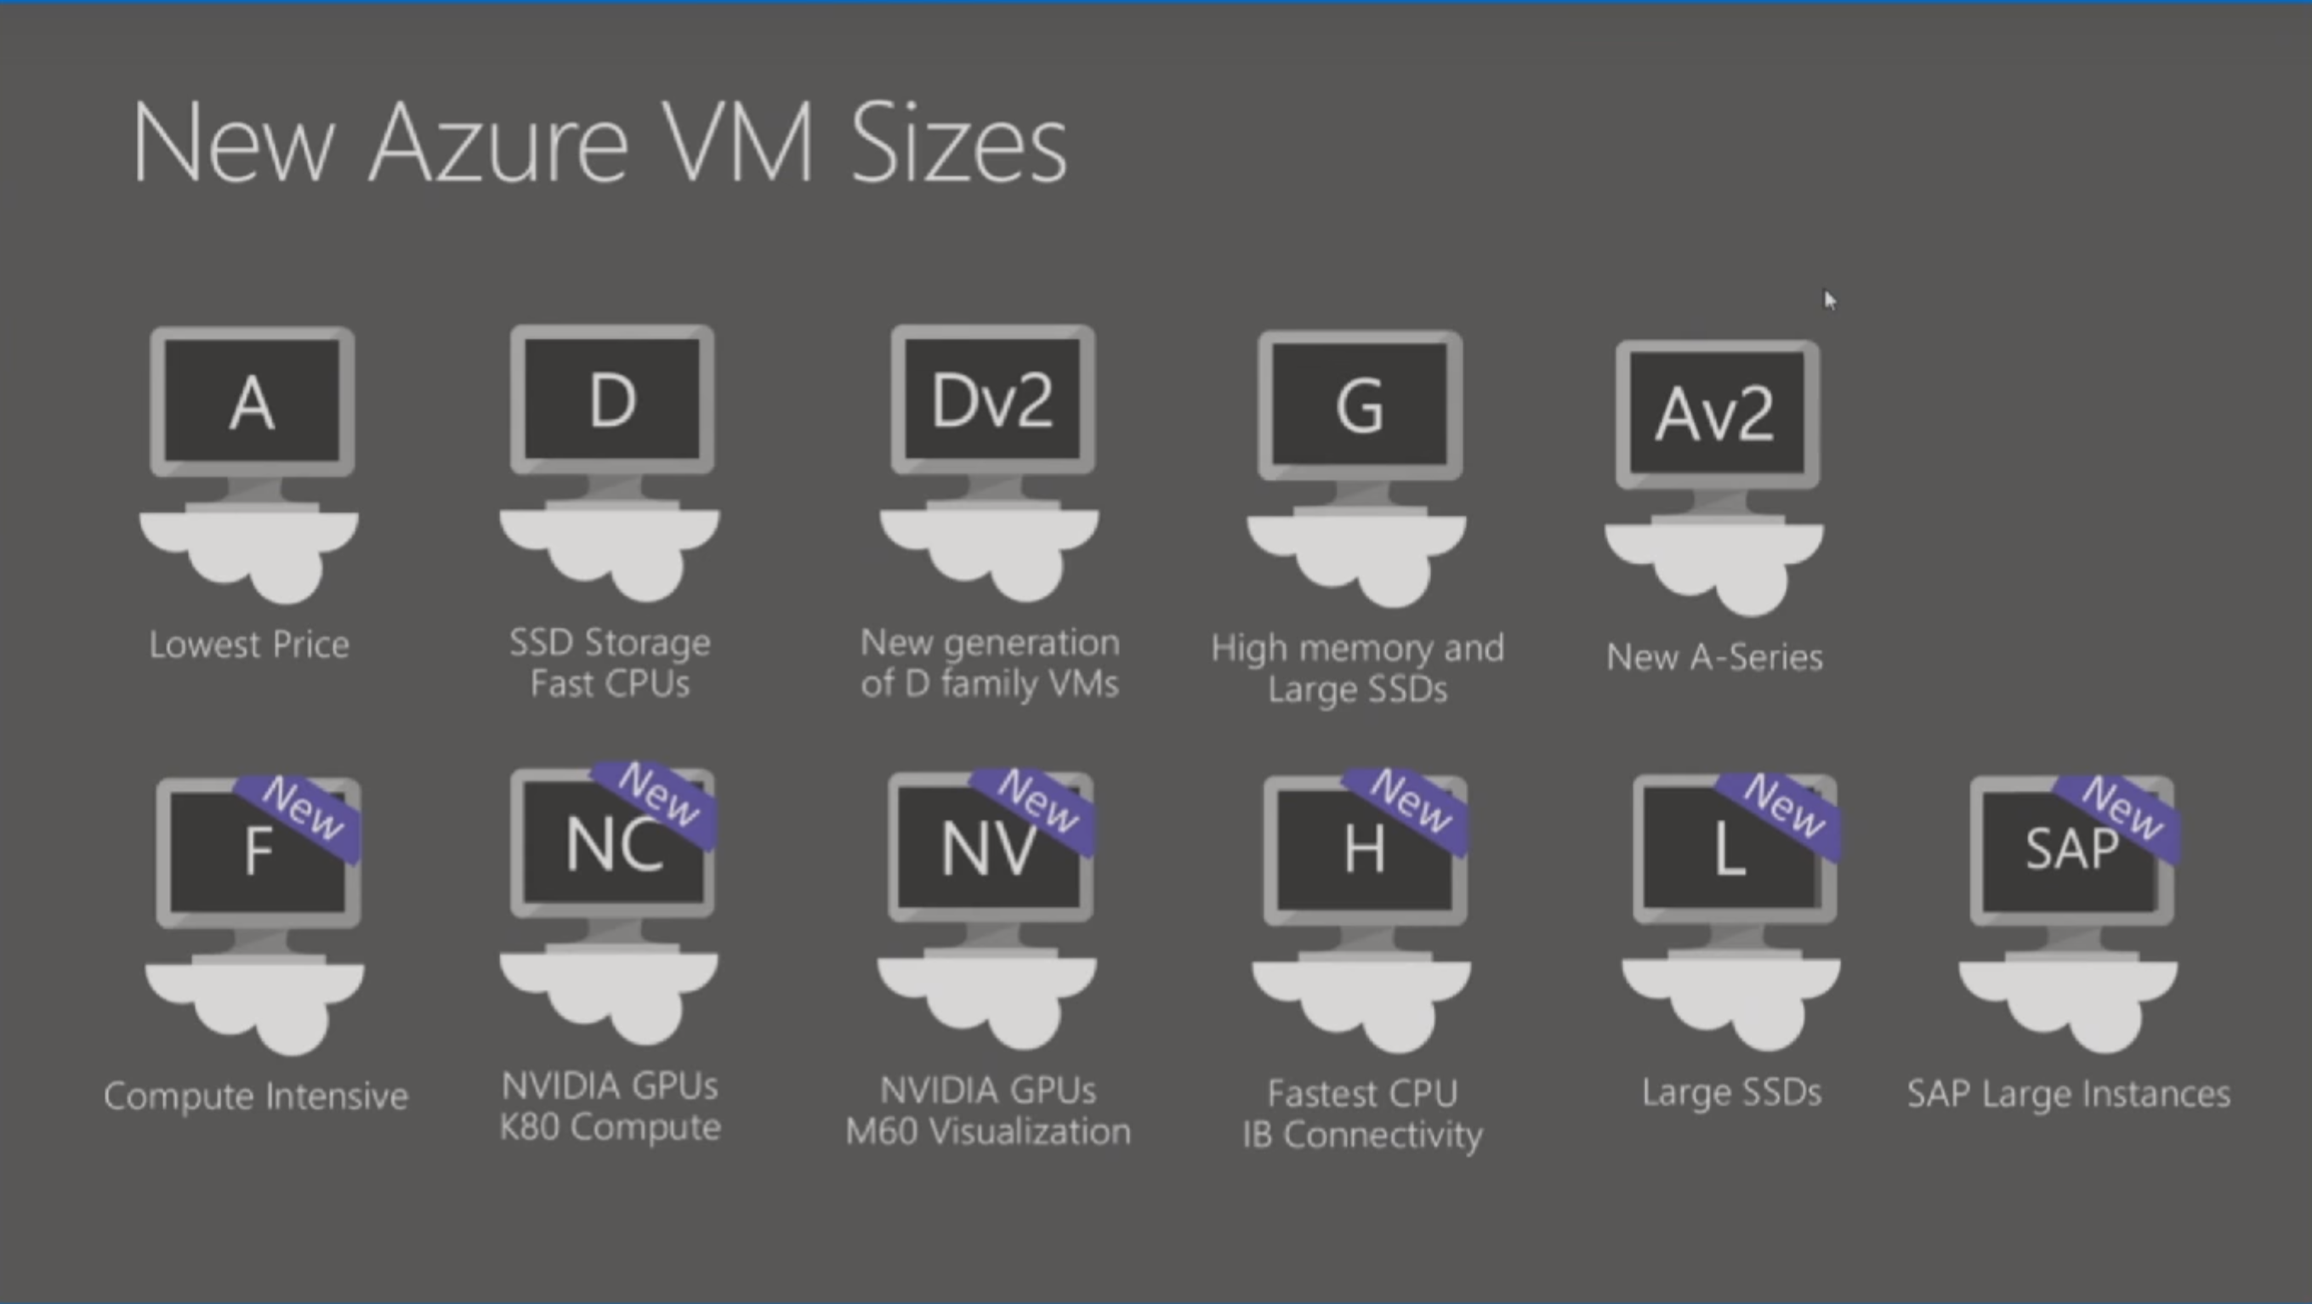
High Performance Compute
Notes:
Point out the NC K80 COMPUTE and the NV M60 Visualization

Slide 47
Latest VM Announcements
New VM SKU’s ND (P40) and NCV2(P100’s) announced
DV3 and EV3 announced with nested virtualization
Notes:
Now even the previous
READ
Designed for training and inference, the new series is powered by NVIDIA Tesla P40 GPUs and based on the new Pascal Architecture. The instances provide more than two times the performance versus the previous generation for FP32 (single precision floating point operations) for artificial intelligence workloads. The ND-series also offers a much larger GPU memory size (24GB).
OK 4 P100 NVIDEA Tesla boards is 24 core GPUs. Forr 1 year during business hours is around 8k. If you paid them outright it would be around 24K. Given advancements in tech it is certainly better to lease the compute instead of buying outright.

Slide 48
If your HPC compute cluster requires a management head node and the choices are Azure Batch or HPC Pack then choose HPC Pack.
Azure Batch doesn’t have management head node.
https://docs.microsoft.com/en-us/azure/cloud-services/cloud-services-setup-hybrid-hpcpack-cluster

Slide 49
Integrate Azure Services
Azure Search
Media
Advanced Analytics

Slide 50
Azure Search Overview
1 of 4
A fully-managed search solution that allows developers to enable search experiences in applications.
Embed a sophisticated search experience into web and mobile applications without having to worry about the complexities of full-text search and without having to deploy, maintain or manage any infrastructure.
Perfect for enterprise cloud developers, cloud software vendors, cloud architects who need a fully-managed search solution.
Surface Your Data
Reduce Complexity
Move Quickly with Confidence
Powerful, guaranteed performance
Sophisticated search
Connects business goals to the application
Simplify search index management
Scale-out easily
Fast time to market
Backed by Microsoft Azure

Slide 51
Azure Search
Use Cases
Ecommerce - Searching for products
News Feed – Newer articles are more relevant
Geospatial search – A Search that is aware of your location.
Unstructured content – Index and search documents
Some Features
Term Boosting – Quiet clean hotel
Synonyms – Motel, Hotel

Slide 52
What you can do with Media Services
Live and on-demand streaming
Digital marketing platforms
Enterprise video management
Reach hundreds of millions of device endpoints.
Services and tools for video preparation, management and publishing.
Distribute and manage corporate communications, IT, HR content and training.

Slide 53
Media Services Applications
Live event streaming service with CDN capabilities
Studio grade encoding
Content protection and encryption
Distribute content across multiple channels and devices
Notes:
I once had a customer who tried to build a cdn from scratch

Slide 54
Question: Your company uses Azure media services to supply advertising media to partners. Multiple channels are configured within a single instance of Media services. You need to enforce a rule that only content that contains a signed security token can be uploaded. How can we enforce this rule ?
Use a Network Security Group
Create an ingest restriction
Use an Access Control List
Set media services authorization policy to Token
Use a Network Security Group
Create an ingest restriction
Use an Access Control List
Set media services authorization policy to Token
Notes:
I purposely didn’t explain auth to show you how you could answer a question. (LOOK FOR WORD TOKEN)
Technically, you can configure auth by configuring a key authorization policy and set the policy to TOKEN. Then enforce that the token contains a verification key, issuer and audience. Clients simply pass the token as a SWT or JWT with a token issued by that criteria.

Slide 55

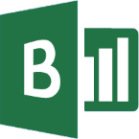

Advanced Analytics
Event production
Collection
Ingestion
Stream Analytics
Storage and
Batch Analysis
Presentation and action
Event Hubs
Event Hubs
Service Bus Queues, Topics
Web/thick client dashboards
Applications
Devices
Stream Analytics
SQL DB, DW
IOT hubs
Legacy IOT (custom protocols)
Search and query
Storage Blobs and Tables
Cloud gateways (web APIs)
Blobs
Document DB
IP-capable devices (Windows/Linux)
Data analytics (Power BI)
Machine
Learning
Azure Data Lake
Low-power devices (RTOS)
Field gateways
Power BI
Devices to take action
Reference Data
more to come…

Slide 56

Some Modelling Techniques in Azure ML
MULTICLASS CLASSIFICATION
Predict failures with their causes within a future time period
Predict remaining useful life within ranges of future periods
REGRESSION or SURVIVAL ANALYSIS
1001001010
ANOMALY DETECTION
Predict remaining useful life, the amount of time before the next failure
Identify change in normal trends to find anomalies
BINARY CLASSIFICATION
Predict failures within a future period of time

Slide 57
Labs
https://github.com/dstolts/70-534/tree/master/Labs
Create an Azure Function + Blob Storage
IoT Pipeline (Stream Analytics -> Service Bus topic -> Function – Blob Storage

Slide 58
Designing Advanced Applications
Eric Franz | Solution Lead
www.concurrency.com

